Slide 1
Efficiency
Year 11 Physics

Slide 2
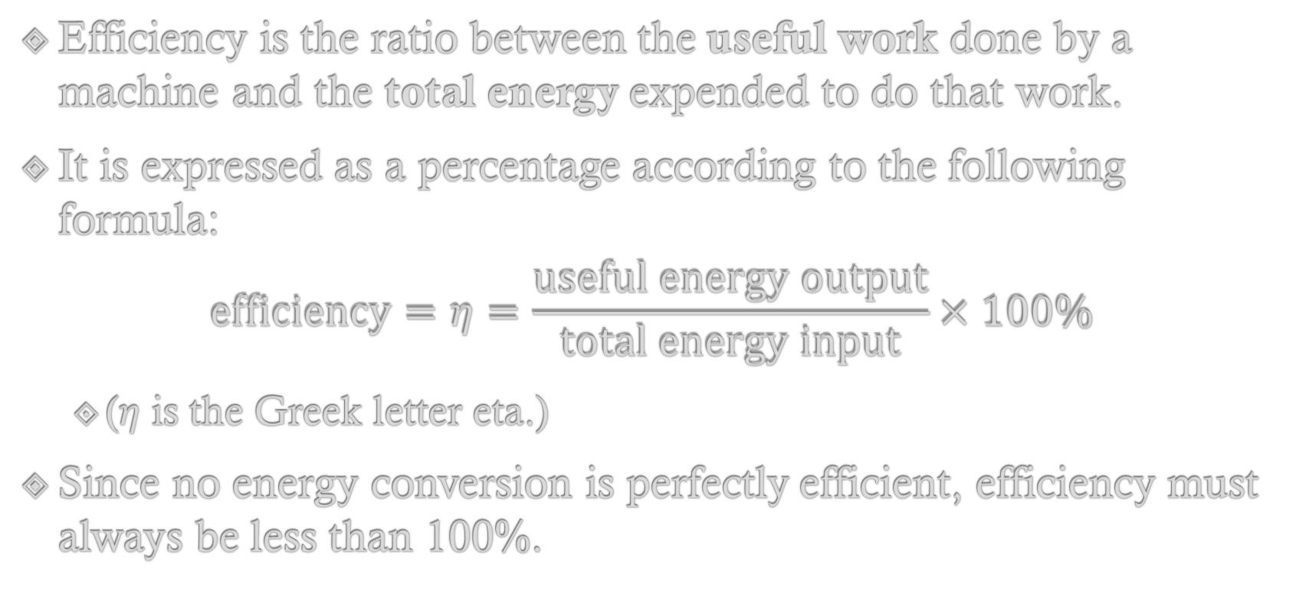
Efficiency
Efficiency is the ratio between the useful work done by a machine and the total energy expended to do that work.
It is expressed as a percentage according to the following formula:
$$\text{efficiency}=η=\frac{\text{useful} \text{energy} \text{output}}{\text{total} \text{energy} \text{input}}×100\%$$
  (𝜂 is the Greek letter eta.)
Since no energy conversion is perfectly efficient, efficiency must always be less than 100%.

Slide 3

Efficiency Calculation #1
An electric drill transforms 3.6 kJ of electrical energy into 2520 J of kinetic energy. What is its efficiency?
$$\text{total} \text{energy} \text{input}=3600 \text{J} \text{useful} \text{energy} \text{output}=2520 \text{J}$$
$$η=\frac{\text{useful} \text{energy} \text{output}}{\text{total} \text{energy} \text{input}}×100\% \\ η=\frac{2520}{3600}×100\%=70\%$$

Slide 4

Efficiency Calculation #2
A coal-fired generator has an efficiency of approximately 30%. If 2000 J of chemical energy is supplied to the generator, then how much is converted into electrical energy?
$$\text{total} \text{energy} \text{input}=2000 \text{J} η=30\%$$
$$30\%=\frac{\text{useful} \text{energy} \text{output}}{2000}×100\%$$
$$\text{useful} \text{energy} \text{output}=0.3×2000=600 \text{J}$$

Slide 5

Efficiency Calculation #3
Ahmed is a heating consultant. One of his clients has a boiler that is 62% efficient and uses heating oil that releases 4.15 × 10⁷ J kg⁻¹ of heat energy when it burns in air. What mass of heating oil does the boiler need to heat 245 kg of water from 12.0 °C to 68.0 °C?
$$\text{useful} \text{energy} \text{output} \text{required}=mcΔT \\ =245×4180×56 \\ =57349600 \text{J}$$

Slide 6
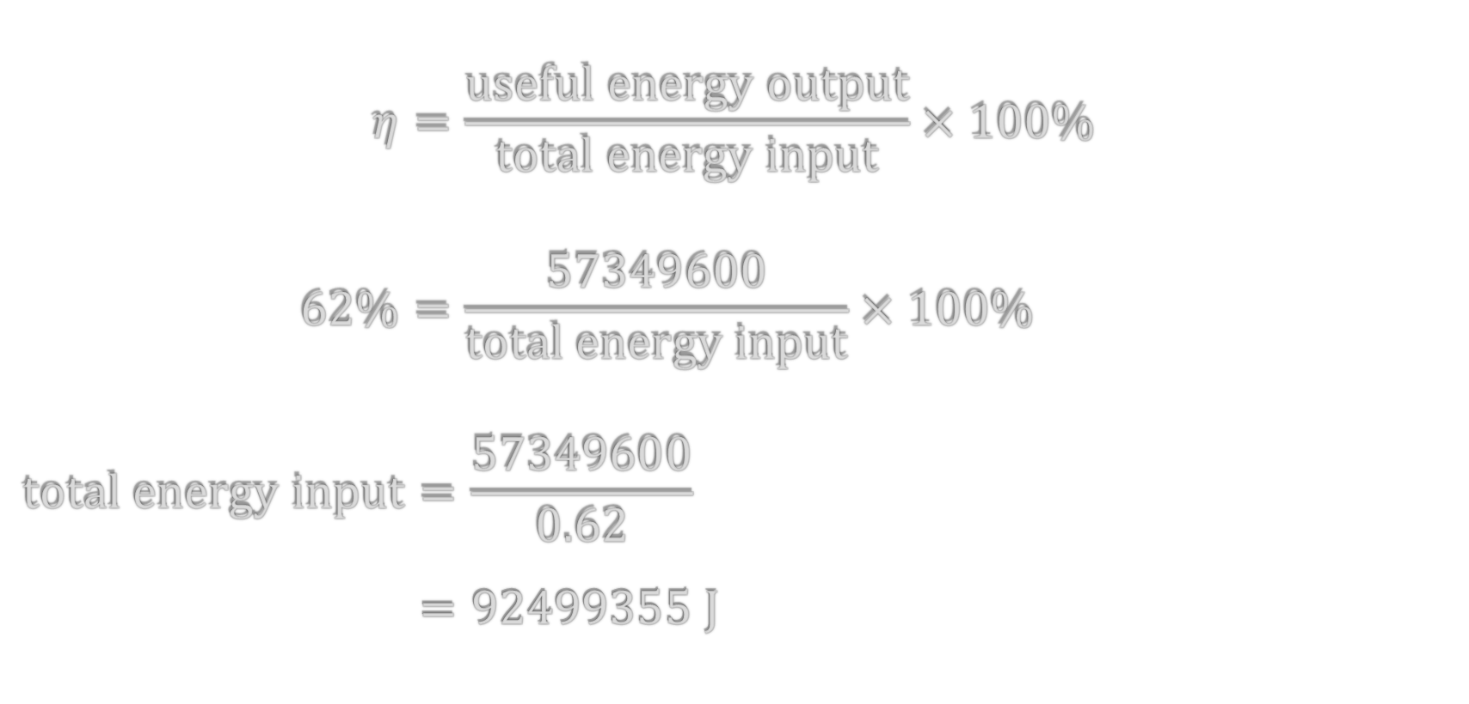
Efficiency Calculation #3
$$η=\frac{\text{useful} \text{energy} \text{output}}{\text{total} \text{energy} \text{input}}×100\% \\ 62\%=\frac{57349600}{\text{total} \text{energy} \text{input}}×100\% \\ \text{total} \text{energy} \text{input}=\frac{57349600}{0.62} \\ =92499355 \text{J}$$

Slide 7

Efficiency Calculation #3
$$m_{\text{oil}}=\frac{92499355}{4.15×{10}^{7}} \\ =2.23 \text{kg}$$

